Slide 1
Project II Proposal
Alex Wang
2008 Apr 6

Slide 2
Read the following two papers to learn the heuristic algorithm of jenny
  Cohen, D.M. Dalal, S.R. Kajla, A. Patton, G.C.
  The Automatic Efficient Test Generator (AETG) System
  Software Reliability Engineering, 1994. Proceedings., 5th International Symposium
  D. M. Cohen, S. R. Dalal, M. L. Fredman, and G. C. Patton
  The AETG System: An Approach to Testing Based on Combinatorial Design
  IEEE Transactions On Software Engineering, July 1997 (Vol. 23, No. 7)
Design the input constraints for jenny engine of our testing tool

Slide 3
M. Grindal, J. Offutt, S. F. Andler
Combination Testing Strategies - A Survey
Software Testing, Verification and Reliability, Vol. 15, No. 3, pp. 167-199, 2005
  Presents 15 different combination strategies, and covers more than 30 papers that focus on one or several combination strategies
  Includes a subsumption hierarchy that attempts to relate the various coverage criteria associated with the identified combination strategies

Slide 4
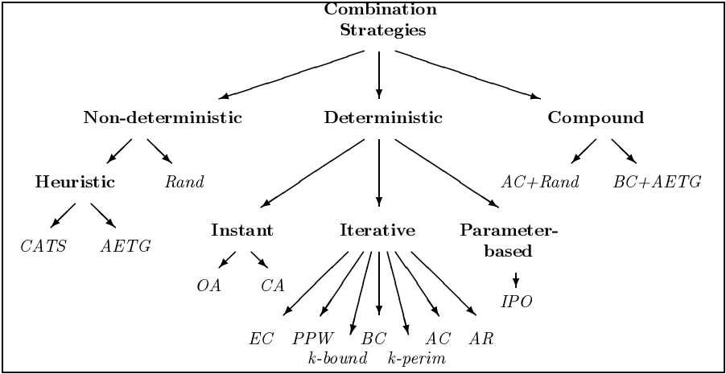
Combination Testing Strategies: A Survey

Slide 5
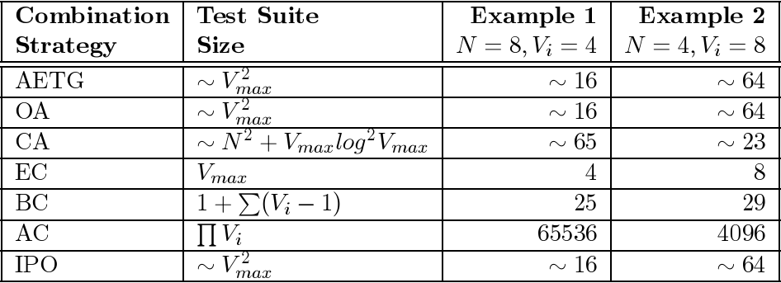
N parameters and Vi values of the ith parameter
Vmax is the largest Vi

Slide 6
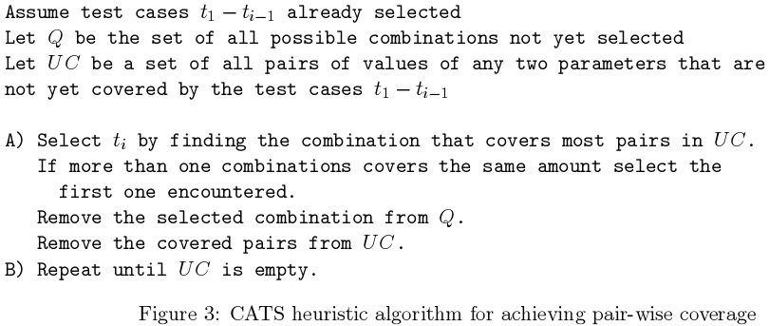
CATS

Slide 7
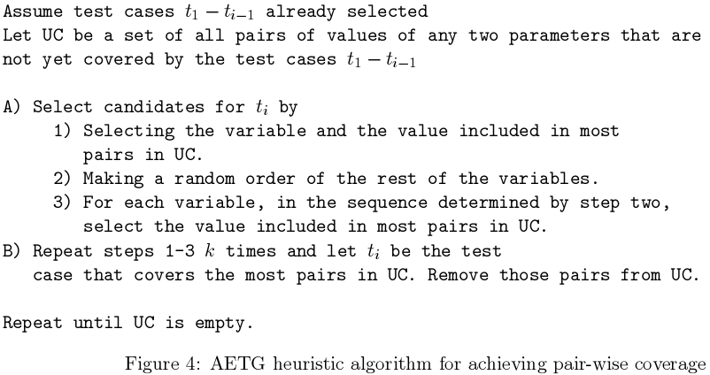
AETG

Slide 8
jenny
jenny first covers single features, then pairs of features, then triples, and so forth up to the n-tuples requested by the user.
Each pass checks whether the existing tests cover all tuples, and if not, make a list of uncovered tuples and add more tests until all tuples are covered. It tries to find testcases that obey the restrictions and cover a lot of new tuples. Any tuple that it can't cover no matter how hard it tries without disobeying some restriction, it says it can't cover it and adds it to its list of restrictions. Then it goes on to one-bigger tuples. The running time is empirically about O(d2.3f4.6) for d dimensions all of size f (for -n2).

